Slide 1
FACEDAR
Detecting Modified Images Using a Convolutional Neural Network
CSCI 5930 Matt Sullivan

Slide 2
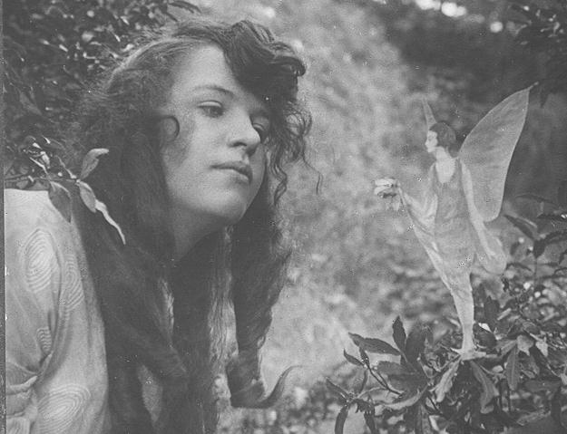
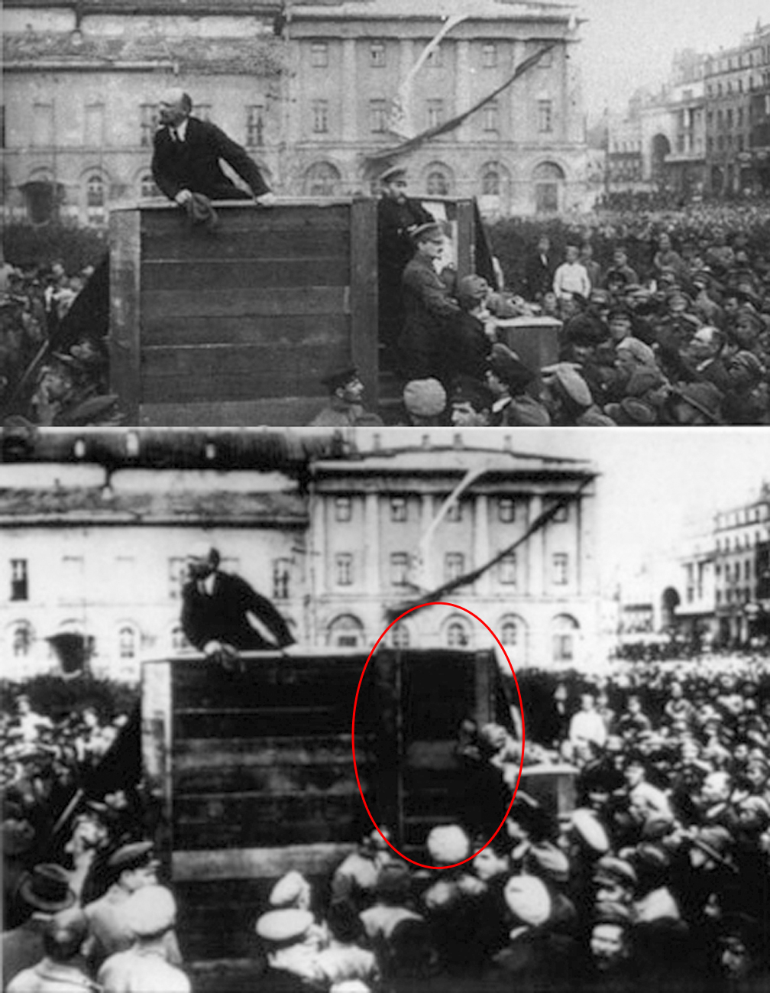
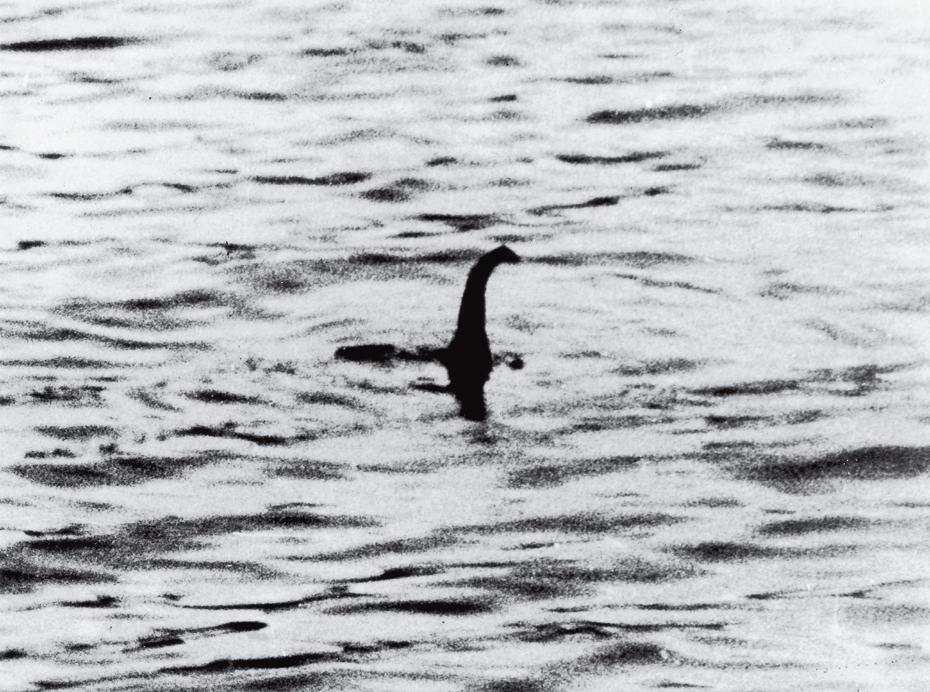
Problem
Since the dawn of photography, images have been manipulated by people to convey false messages.
With the rise of digital images and digital photo editors (Photoshop, GIMP, etc), image manipulation has never been more accessible to the public.

Slide 3
"Fake News"
37 million false news posts made in 2016[1]
40% of Americans reported social media as a "major" source of news
88% of Americans think false news has created "a great deal" or "some" confusion[2]
84% of Americans think they can spot false news articles[3]
75% of Americans cannot spot false news.[3]
Many news articles and infographics are accompanied by digitally manipulated images.
Is there anything we can do to combat misinformation in images?

Slide 4
Proposed Solution: FACEDAR
Is it possible to train a convolutional neural network to recognize digitally manipulated images?
I used the Real and Fake Face Detection Dataset created by Computational Intelligence and Photography Lab, Yonsei University[4] to train the network.
In order to detect manipulated images, I converted the images in the dataset using a technique called Error Level Analysis.

Slide 5
Error Level Analysis
Technique proposed by Dr. Neal Krawetz[5]
Uses the fact that JPEG has a "lossy" compression algorithm
Re-saves images at a different compression ratio, and compares it to the base image
It then returns an image illustrating the differences

Slide 6
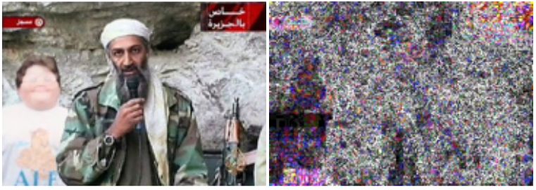

Slide 7
Hardware/Limitations
Intel Core i5-4200H Processor @ 2.80 Ghz
NVIDIA Geforce GTX 860M / 2GB GDDR5 (CUDA/cuDNN enabled)
8GB DDRIII(L) RAM

Slide 8
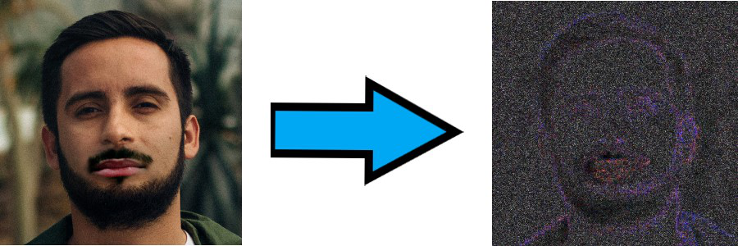
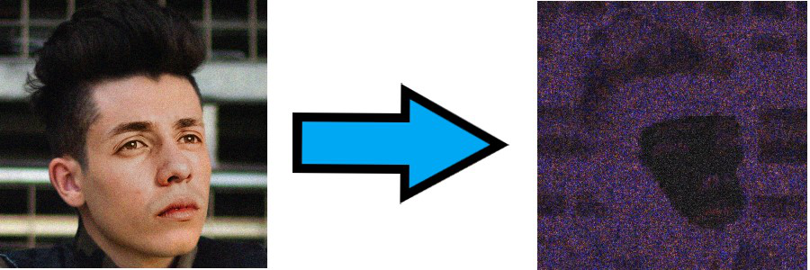
High Level Design/Architecture
Step 1: Convert Dataset images into ELA images

Slide 9
Methodology
Step 2: Preprocess Imagery
Step 3: Design Neural Network
Start Small
Trial and Error
Hardware Limitations

Slide 10
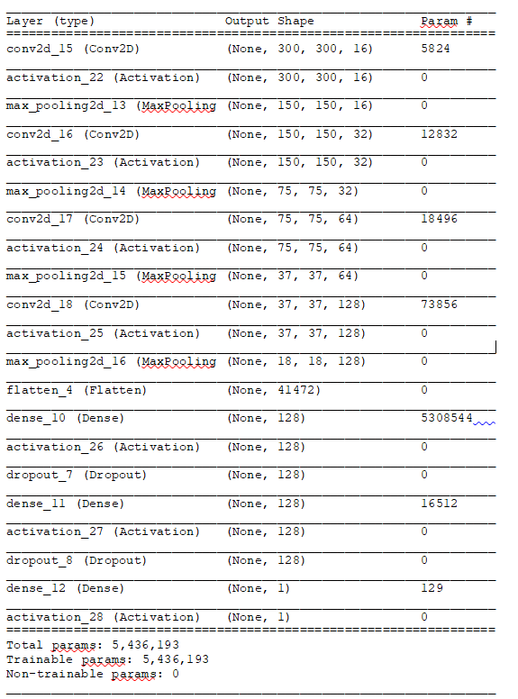
Final Model
Layers

Slide 11
CNN Part 1

Slide 12
CNN Part 2

Slide 13
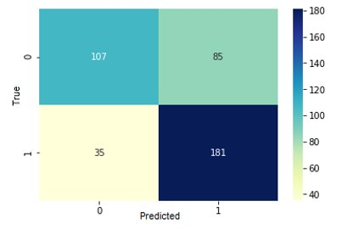
Results/Analysis

Slide 14
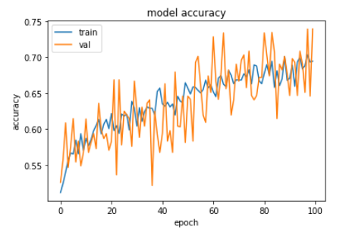
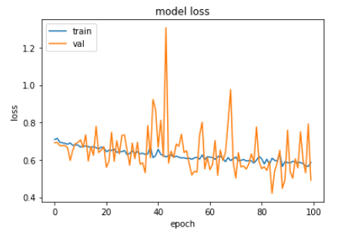
Results/Analysis

Slide 15
Summary
I was able to train a convolutional neural network to identify modified images 70% of the time using Error Level Analysis on JPEG images.
This serves as proof of concept that it is possible for CNNs to identify manipulated images

Slide 16
Future Work
Experiment with more hyperparameters and CNN structures
Obtain larger training dataset
Longer training time for model
Run it on better hardware
Build a framework (GUI or browser plug in) that makes it easy for a layperson to use

Slide 17
References
[1] H. Allcott et al, “Social Media and Fake News in the 2016 Election”, Journal of Economic Perspectives—Volume 31, Number 2—Spring 2017—Pages 211–236
[2] C. Silverman, “Most Americans Who See Fake News Believe It, New Survey Says”, Buzzfeed News, 12/6/16, https://www.buzzfeednews.com/article/craigsilverman/fake-news-survey#.mlxj9PKPG4https://www.buzzfeed.com/craigsilverman/fake-news-survey?utm_term=.rmnKLVXVYv
[3] M. Barthel et al, “Many Americans Believe Fake News Is Sowing Confusion”, 12/15/16, Pew research Centerhttps://www.journalism.org/2016/12/15/many-americans-believe-fake-news-is-sowing-confusion/?utm_source=Pew+Research+Center&utm_campaign=e080af4f66-EMAIL_CAMPAIGN_2016_12_14&utm_medium=email&utm_term=0_3e953b9b70-e080af4f66-400229353, last accesssed 4/22/2020
[4] Real and Fake Face Detection, Computational Intelligence and Photography Lab, Yonsei University, https://www.kaggle.com/ciplab/real-and-fake-face-detection, last accessed 4/22/2020
[5] N. Krawetz, “A Picture’s Worth… Digital Image Analysis and Forensics,” Black Hat Briefings USA, Las Vegas, Nevada, July/August, 2007 https://www.blackhat.com/presentations/bh-dc-08/Krawetz/Whitepaper/bh-dc-08-krawetz-WP.pdf

